Slide 1
Repository Pattern (Part 2)
.NET Development

Slide 2
Concept of a generic repository
We must do better than this!
Instead of creating (and copying) individual repositories for each entity class, in some cases developers make use of a so-called generic repository.
A generic repository is a generic class, with basic CRUD methods in it (and of course other methods can be added as needed) without specifying the exact entity.
This means, if we have entities Movie and Rating, this single generic repository class can be used for both of them. We specify the entity during instantiation.
In the exercise, we use a different approach: an abstract class and inheritance.

Slide 3
Create a generic repository
First make a copy of your ASP.NET MVC demo application so far.
Now open this copy and in the DAL folder create a new class ‘GenericRepository.cs’
Implement the IRepository interface for a <T> entity
As a rule, the more types you can parameterize, the more flexible and reusable your code becomes. However, too much generalization can create code that is difficult for other developers to read or understand. Here the parameter passed is by constraint an Entity Class which is a reference type.

Slide 4
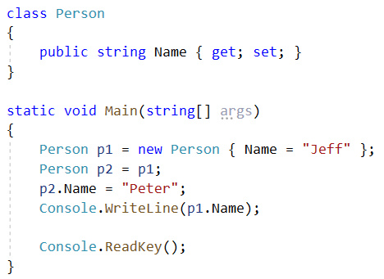
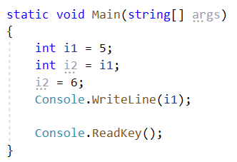
Quiz

Slide 5
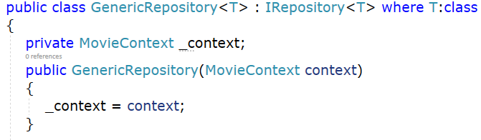
Create a generic repository
First step is to make sure the Repository can access the database context (MovieContext). This DbContext is defined in a class variable (_context), and the constructor expects the calling object to pass in an instance of the context.

Slide 6
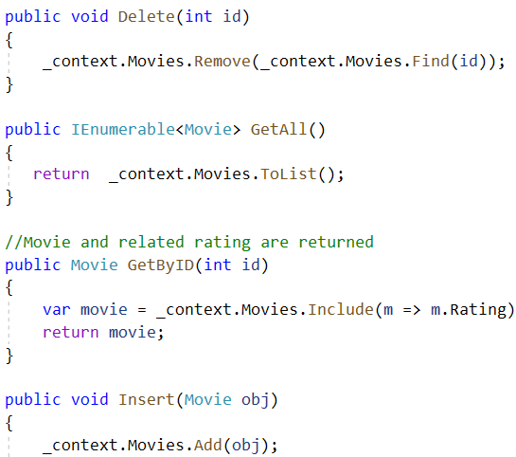
DbSet in CRUD-methods
What DbSet to be used in generic class <T>?
_context.Set<T>()

Slide 7
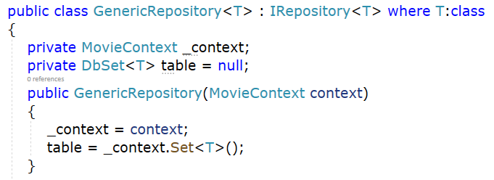
Create a generic repository
In every CRUD method the DbSet of the T entity is needed. This DbSet<T> is defined in a class variable table that gets initialized in the constructor. Then use table instead!

Slide 8
Create a generic repository
Change _context.Movies and _context.Ratings for example to table.Insert(object)

Slide 9
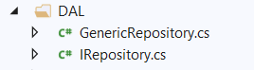
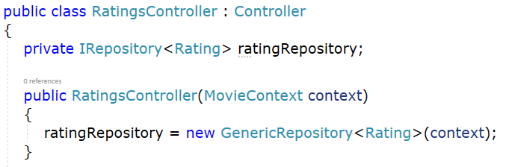
Let the RatingsController use the generic repository
Delete the RatingRepository from the DAL.
Change the RatingsController constructor to make sure the new GenericRepository<Rating> is used.

Slide 10
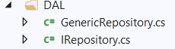
Let the MoviesController use the generic repository
Delete the MovieRepository from the DAL
Do the same modifications for the MoviesController!

Slide 11
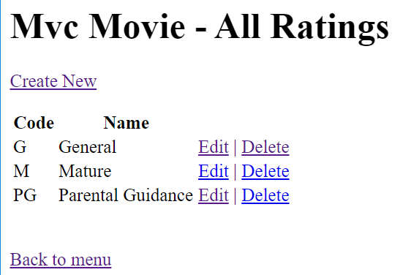
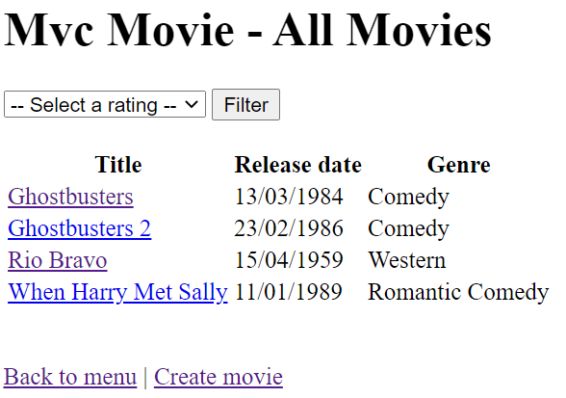
Test AllRatings & AllMovies
All actions should work identically. The main difference is now that the controller calls the GenericRepository for all data transactions.

Slide 12
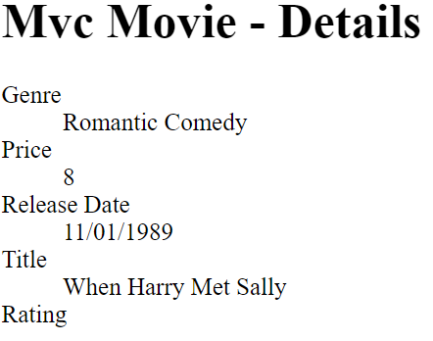
Test AllRatings & AllMovies
There is still an issue because in the generic repository the eager loading (.Include) is not available. We can't modify the GetByID from our MovieRepository anymore.
Rating Name is not loaded!

Slide 13
Extend the generic repository
Best practice is to add this extra method GET to the interface and the generic repository. Goal is provide the possibility to pass LINQ expressions (Where – OrderBy – Include) as parameters to the repository GET method.
Let's start with the interface:
IEnumerable<T> Get(
Expression<Func<T, bool>> filter = null,
Func<IQueryable<T>, IOrderedQueryable<T>> orderBy = null,
params Expression<Func<T, object>>[] includes);

Slide 14
Extend the generic repository
public IEnumerable<T> Get(
Expression<Func<T, bool>> filter = null,
Func<IQueryable<T>,IOrderedQueryable<T>> orderBy = null,
params Expression<Func<T, object>>[] includes)
{
IQueryable<T> query = table;
foreach (Expression<Func<T, object>> include in includes)
query = query.Include(include);
if (filter != null)
query = query.Where(filter);
if (orderBy != null)
query = orderBy(query);
return query.ToList();
}

Slide 15
Extend the generic repository
The Get-method is called to eager load the Rating properties when getting the MovieDetails.
public IActionResult Details(int id)
{
var movie = movieRepository.Get(
filter: x => x.MovieID == id,
includes: x => x.Rating).FirstOrDefault();
return View(movie);
}

Slide 16
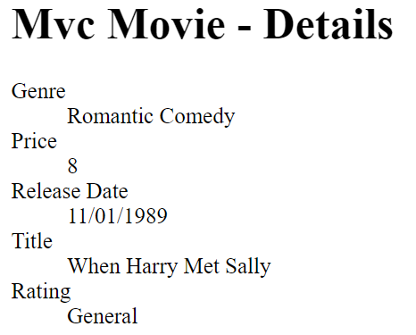
Test AllMovies
After extending the Generic Repository the Rating entities values are eager loaded.
Rating Name is loaded!

Slide 17
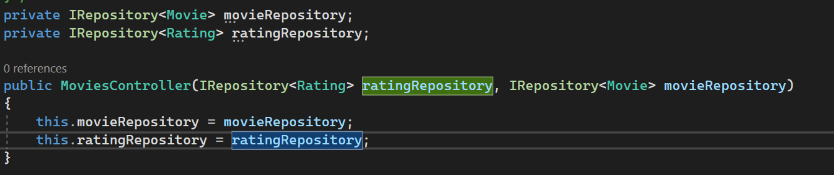
What about Dependency Injection?
Exercise: Try to inject the Repositories instead of the Context in the Controllers (MoviesController and RatingsController)!

Slide 18
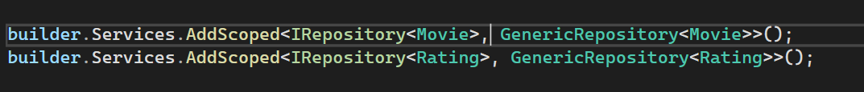
Register the repositories
Register both generic repositories (Movie and Rating) in the DI container
Program.cs:

Slide 19
Rerun the application
Make sure everything still works as expected
We should get all our ratings/movies from the DB

Slide 20
Refactoring the List-method of the MoviesController
if (ratingID != 0)
{
listMoviesVM.Movies = movieRepository.GetAll()
.Where(m => m.RatingID == ratingID)
.OrderBy(m => m.Title).ToList();
}
else
{
listMoviesVM.Movies = movieRepository.GetAll()
.OrderBy(m => m.Title).ToList();
}
listMoviesVM.Ratings =
new SelectList(ratingRepository.GetAll().OrderBy(r => r.Name),
"RatingID", "Name");
...

Slide 21
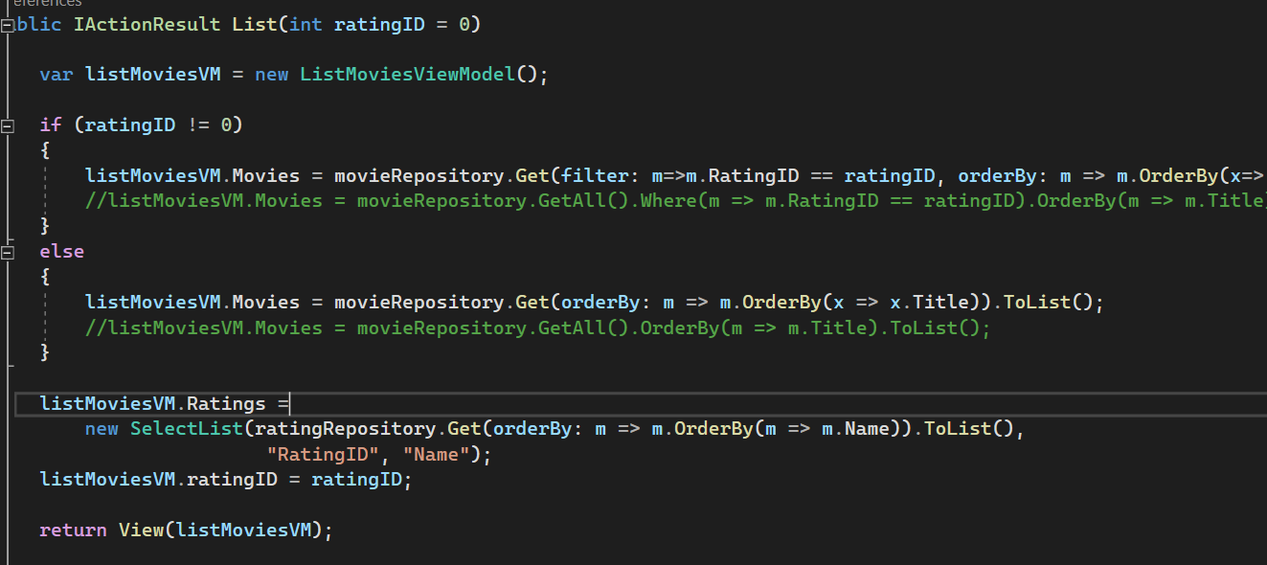
Refactoring the List-method of the MoviesController

Slide 22
Done!
In the exercise, we use a third approach: an abstract class and inheritance.

